Slide 1


open twin
Multi physics and multi scale simulation
Frankfurt University of Applied Sciences, Faculty 2, ©2020 Prof. Dr.-Ing. Peter Thoma
1

Slide 2
Open twin introduction Agenda
Challenges
1.1 Multi Domain and Multi Scale
1.2 Computational Resources
1.3 Data Management / Data Analytics
Open Twin
2.1 System Requirements Overview
2.2 Why Open Twin?
2.3 Architecture and Design
Open Twin Status and Research
Next Steps

Slide 3
Open twin introduction Agenda
Challenges
1.1 Multi Domain and Multi Scale
1.2 Computational Resources
1.3 Data Management / Data Analytics
Open Twin
2.1 System Requirements Overview
2.2 Why Open Twin?
2.3 Architecture and Design
Open Twin Status and Research
Next Steps

Slide 4
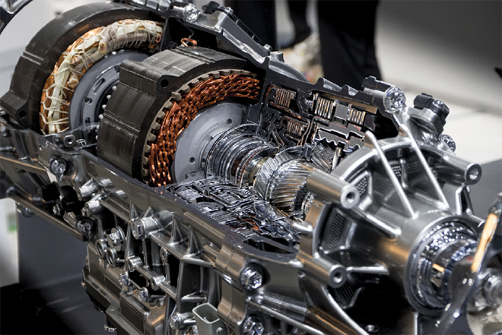
1. Engineering Challenges
https://chargedevs.com/features/a-closer-look-at-the-losses-in-ev-motors/
Example: Tesla Model 3: 225 kW, Length = 23 cm, Diameter = 23 cm

Slide 5

1. Engineering Challenges
Electromagnetic performance
Noise vibration harshness
Materials (magnets)
System integration (inverter)
https://chargedevs.com/features/a-closer-look-at-the-losses-in-ev-motors/
Durability
Lubrication
Multi body motion
Thermal management
Example: Tesla Model 3: 225 kW, Length = 23 cm, Diameter = 23 cm

Slide 6

1. Software Tool Challenges
Physics
HPC
Data
https://chargedevs.com/features/a-closer-look-at-the-losses-in-ev-motors/

Slide 7
1. Software Tool Challenges
Physics
HPC
Data
https://chargedevs.com/features/a-closer-look-at-the-losses-in-ev-motors/

Slide 8
1.1 multi domain multi scale simulation
Structural Mechanics
Electro-magnetics
Fluid Dynamics
Multi Domain
Thermo- dynamics
Material Science
Strong and weak coupling of multiple
physics domains

Slide 9
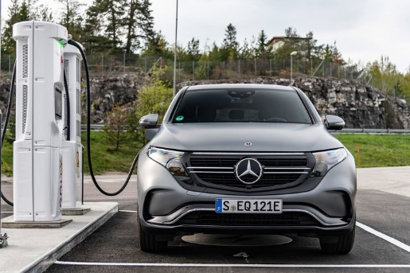
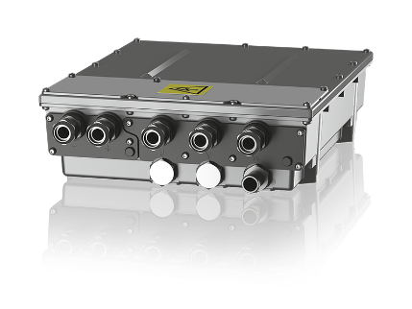

1.1 multi domain multi scale simulation
Multi Scale
Structural Mechanics
Electro-magnetics
Fluid Dynamics
Product
© Mercedes Benz
Multi Domain
Geometrical scale / complexity
Part
Thermo- dynamics
Material Science
© ZF
Material
© Egorov Artem
Example: EMC / EMI

Slide 10
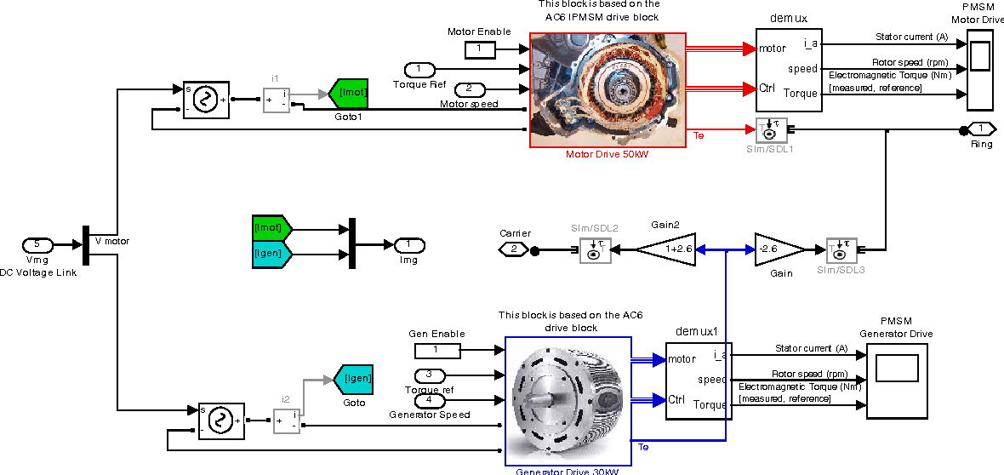
1.1 multi domain multi scale simulation
Structural Mechanics
Electro-magnetics
Fluid Dynamics
System
(MBSE)
Thermo- dynamics
Material Science
© Toyota
Multi Fidelity

Slide 11

1.1 multi domain multi scale simulation
System level Simulation
Problem specific accuracy requirements
Realtime ⬄ High-precision simulation
Derive system models from physical simulation
Parameter fittings (physics-based models)
Surrogate models („Black Box“)
Model order reduction (often solver specific)
„Curse of the dimension“ ⇨ Neural network (AI)
Adjoint sensitivities ⇨ Efficiency
System modelling
Signal flow modelling, causal (e.g. Simulink)
Equation based, non causal (e.g. Modelica)
FMI (causal, co-simulation or model exchange
© Carmaker
© Toyota

Slide 12
1.1 multi domain multi scale simulation
coupling Framework
1
Domain 1
Domain 2
Sequential

Slide 13
1.1 multi domain multi scale simulation
coupling Framework
1
Domain 1
Domain 2
Sequential
Domain 1
M₁
K
2
M=
Iterative
Co-
Simulation
K‘
M₂
Domain 2

Slide 14
1.1 multi domain multi scale simulation
coupling Framework
1
Domain 1
Domain 2
Sequential
Domain 1
M₁
K
2
M=
Iterative
Co-
Simulation
K‘
M₂
Domain 2
Domain 1
Surrogate model 1
3
causal,
non causal
System
Simulation
Domain 2
Surrogate model 2

Slide 15
1.1 multi domain multi scale simulation
coupling Framework
DOF coupling (0D, 1D, 2D, 3D)
Problem specific conservation of properties (average values, maximum values, etc.)
See also: MPCCI, preCICE
Cooperation with suppliers, IP protection
1
Domain 1
Domain 2
Sequential
Domain 1
M₁
K
2
M=
Iterative
Co-
Simulation
K‘
M₂
Domain 2
Domain 1
Surrogate model 1
3
causal,
non causal
System
Simulation
Domain 2
Surrogate model 2

Slide 16
1.1 multi domain multi scale simulation
coupling Framework
DOF coupling (0D, 1D, 2D, 3D)
Problem specific conservation of properties (average values, maximum values, etc.)
See also: MPCCI, preCICE
Cooperation with suppliers, IP protection
1
Domain 1
Domain 2
Sequential
Domain 1
M₁
K
2
M=
Iterative
Co-
Simulation
K‘
M₂
Domain 2
Domain 1
Surrogate model 1
Convergence and Consistency?
D. Estep , V. Carey , V. Ginting , S. Tavener , T. Wildey:
A posteriori error analysis of multiscale operator decom-position methods for multiphysics models, SIAM Journal on Numerical Analysis 2008 ⇨ Idea: Operator formulation, adjoint problem
3
causal,
non causal
System
Simulation
Domain 2
Surrogate model 2

Slide 17
1.1 multi domain multi scale simulation
automation and optimization
Automation of individual simulations (model preparation, meshing)
Optimization Platform
Sequential optimization of individual domains ⇨ Multi-domain optimization
Inefficient due to large differences in runtimes of individual domain simulations
Improved efficiency due to sequential application of varying levels of fidelity for domain simulations (optimal method is problem dependent ⇨ flexible optimization platform needed)
Optimization Strategies
Parameter optimization (discrete / continuous, local / global, surrogate models, sensitivities)
„Space Mapping“, etc.
Topology optimization
Domain 1
Domain 1
Domain 2
Domain 2
Domain 3
Domain 3
Domain 4
Domain 4

Slide 18
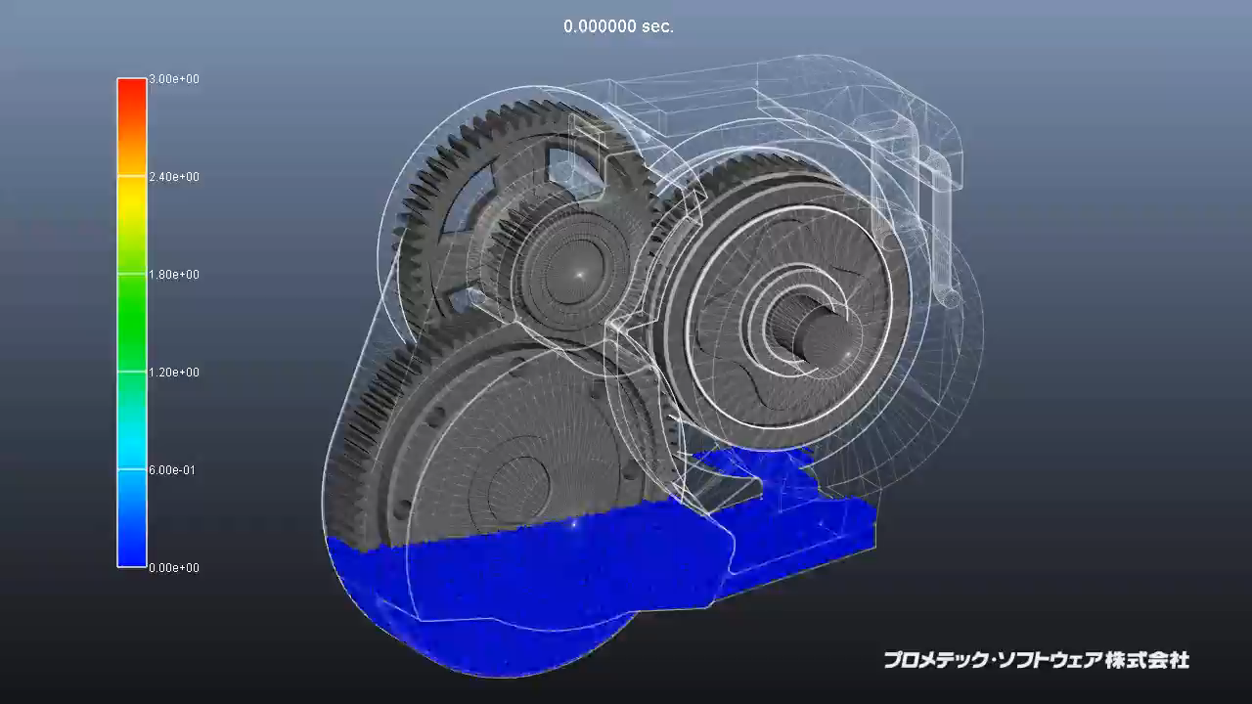
1.1 multi domain multi scale simulation
active research example
Gearbox Lubrication
Source: EnginSoft
Open problem:
Air entrainment at high rotation speed (> 20.000 rpm)
Some research codes are available, no commercial solution yet

Slide 19
1.1 multi domain multi scale simulation
software requirements for multi physics / multi scale simulation
Structural Mechanics
Flexible coupling of simulation domains and simulation codes
Include highly specialized niche solutions
Include research codes
Include in-house codes
Support flexible automation and problem specific optimization
Electro-magnetics
Fluid Dynamics
System
(MBSE)
Thermo- dynamics
Material Science

Slide 20
1. Software Tool Challenges
Physics
HPC
Data
https://chargedevs.com/features/a-closer-look-at-the-losses-in-ev-motors/

Slide 21

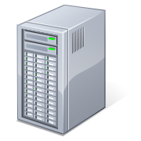
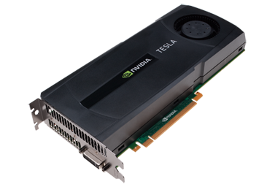

1.2 computational resources
high performance computing architecture
Parallel
(distributed)
file system
Distribution of data / load balancing
Data transfer performance
⇨ Development of specific algorithms
MPI
Infiniband: 20 Gbit/s
CUDA,
OpenCL
OpenMP
Nvidia Tesla V100:
- 7200 Gbit/s
- 5120 Cores
SIMD
Intel Xeon 8176: 620 Gbit/s, 28 Cores

Slide 22
1.2 computational resources
high performance computing architecture
Parallel
(distributed)
file system
Distribution of data / load balancing
Data transfer performance
⇨ Development of specific algorithms
MPI
Infiniband: 20 Gbit/s
CUDA,
OpenCL
OpenMP
Nvidia Tesla V100:
- 7200 Gbit/s
- 5120 Cores
SIMD
Intel Xeon 8176: 620 Gbit/s, 28 Cores
Local computation resources (e.g. laptops) are often not sufficient ⇨ compute cluster / cloud

Slide 23
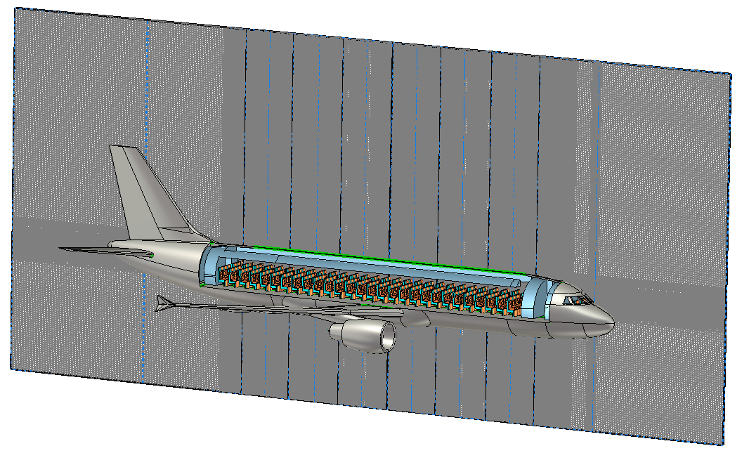
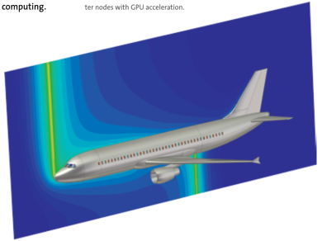
1.2 computational resources
visualization
Images © Dassault Systèmes
Example (explicit transient simulation – Finite Difference scheme)

Slide 24
1.2 computational resources
visualization
Images © Dassault Systèmes
Example (explicit transient simulation – Finite Difference scheme)
25e9 mesh cells ⇨ 150e9 degrees of freedom ⇨ 1.200 GB of data per time step,
30.000 time steps ⇨ 36.000 TB simulation data
⇨ Integration of simulation and visualization
⇨ Visualization and computation of secondary quantities is a HPC problem

Slide 25
1.2 computational resources
visualization
Micro Services
Data
Visualization
Domain
specific
data
Data
Source
Filtering,
Mapping
Rendering
Pixel Stream
Interaction
Data
Visualization
Data
Data
Visualization
Images © Dassault Systèmes
Data
Visualization
Open and modular architecture
Only the data source is domain specific
Visualization of large data sets on any device

Slide 26
1.2 computational resources
visualization
Micro Services
Solver
Domain
specific
data
Data
Source
Filtering,
Mapping
Rendering
Visualization
Pixel Stream
Data
Interaction
Solver
Visualization
Data
Data
Solver
Visualization
Data
Images © Dassault Systèmes
Solver
Open and modular architecture
Only the data source is domain specific
Visualization of large data sets on any device
Real-time visualization during the simulation
Visualization
Data

Slide 27
1. Software Tool Challenges
Physics
HPC
Data
https://chargedevs.com/features/a-closer-look-at-the-losses-in-ev-motors/

Slide 28
1.3 data management data analytics
simulation data management
Data of arbitrary type and source „Variety“
Large amounts of data „Volume“
Very large data sets (e.g. simulation results)
Many smaller data sets (e.g. real time sensor data)
High performance access to data „Velocity“
Visualization, processing of sensor data, etc.
Immutable data (certification) „Validity“
Maximum gain of information from data „Value“
Distributed data storage
Data security
Simulation data management (revisions)
Big-Data

Slide 29

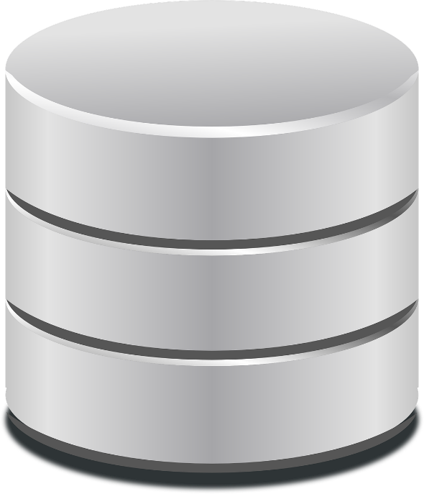
1.3 data management data analytics
vs.
Data stored in file system does not allow for efficient data analysis ⇨ Data Base
Additional meta data can be generated at any time by running distributed analysis on database (lambda layer) ⇨ Flexible Analytics
Potential applications: Knowledge capture, statistics, training data for AI, …, ?

Slide 30
Open twin introduction Agenda
✓
Challenges
1.1 Multi Domain and Multi Scale
1.2 Computational Resources
1.3 Data Management / Data Analytics
Open Twin
2.1 System Requirements Overview
2.2 Why Open Twin?
2.3 Architecture and Design
Open Twin Status and Research
Next Steps
✓
✓
✓

Slide 31
2.1 System requirements overview
Physics
HPC
Data
https://chargedevs.com/features/a-closer-look-at-the-losses-in-ev-motors/

Slide 32
2.1 System requirements overview
Integration Platform (Automation / Optimization)
System Simulation (Model Based Systems Engineering)
Multi-Domain / Multi-Scale Simulation
Model
Preparation
High Performance Computing (HPC)
Visualization
Storage and Processing of Large Data Sets (Big Data)

Slide 33
Open twin introduction Agenda
✓
Challenges
1.1 Multi Domain and Multi Scale
1.2 Computational Resources
1.3 Data Management / Data Analytics
Open Twin
2.1 System Requirements Overview
2.2 Why Open Twin?
2.3 Architecture and Design
Open Twin Status and Research
Next Steps
✓
✓
✓
✓

Slide 34
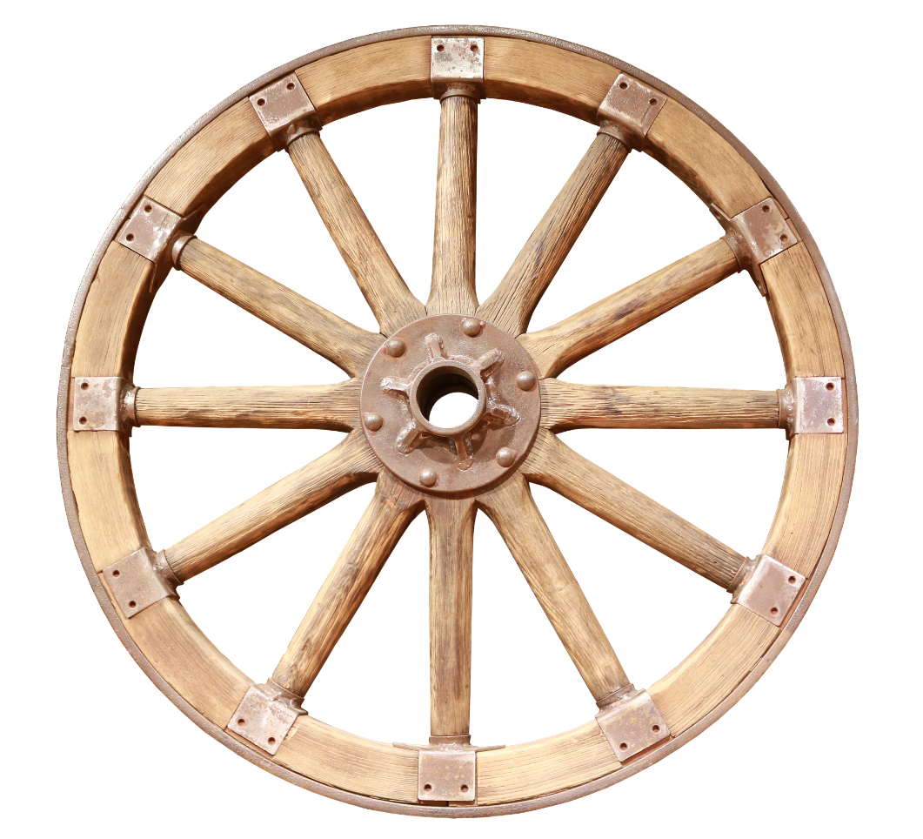
2.2 why open twin
There are lots of powerful solutions available already – why Open Twin?
Are we going to re-invent the wheel?

Slide 35
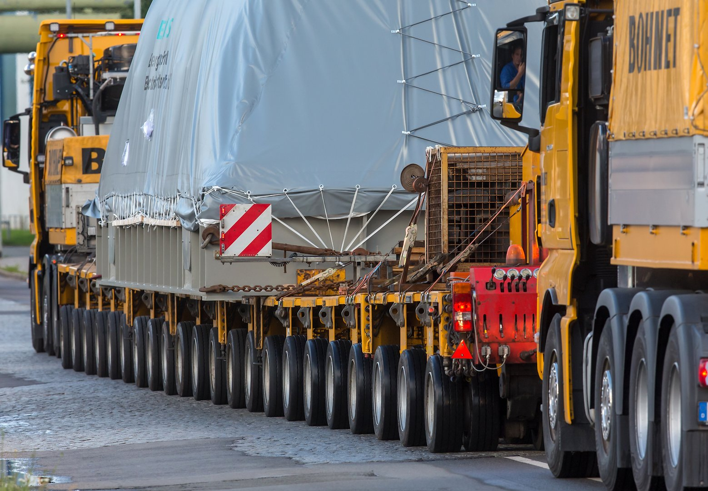
2.2 why open twin
No! The Open Twin integrates existing technology
to provide more powerful solutions

Slide 36
2.2 why open twin
The purpose of open Twin is integration
A large variety of commercial, in-house or academic solutions are available (e.g. Onelab, getDP, Moose, ngsolv,…)
In-house or academic tools often don’t have the necessary infrastructure (pre- / post-processing, data management) to support industrial application
When developing research codes, often simple infrastructures are developed repeatedly (re-inventing the wheel)
Commercial solutions are often not open enough to integrate third party solutions
Open Twin provides existing solutions with an infrastructure to handle:
complex (coupled) physics problems
large amounts of data
heavy computations
many computations

Slide 37
2.2 why open twin
Key capabilities of open Twin - Unique combination
Distributed application
Supports local workstations, compute cluster, cloud
Data is stored in a data base rather than in the file system
Minimize data transfer (map & reduce approach, remote visualization)
Open – allow for integration of existing technology
Open source – freely available for commercial and non-commercial use

Slide 38
Open twin introduction Agenda
✓
Challenges
1.1 Multi Domain and Multi Scale
1.2 Computational Resources
1.3 Data Management / Data Analytics
Open Twin
2.1 System Requirements Overview
2.2 Why Open Twin?
2.3 Architecture and Design
Open Twin Status and Research
Next Steps
✓
✓
✓
✓
✓

Slide 39
2.3 architecture and design
Microservice Framework
Versioned API
Versioned API
Versioned API
Versioned API
Versioned API
Versioned API
Versioned API
User Interface
(1)
Model management
(1)
Generic visualization
(1...n)
Meshing
(1…n)
Result visualization
(1…n)
Simulator plugin
(1…n)
Automation and Optimization
(1)
Microservice:
Serves a business purpose (contract ⇨ testing)
API hides implementation and technology
May contain a UI
Small
Easy to replace
Developed by one team
Data storage

Slide 40
2.3 architecture and design
Microservices = Concept for software modularization
Advantages:
Provide scalability for complex systems
Support for mixed programming languages & environments
Development teams focus on individual microservices
Develop, test, and deploy versioned microservices independently
Support for multiple versions of services
Support for mix of different license models (incl. GPL)
Disadvantages:
Distributed system adds extra complexity and overhead

Slide 41
2.3 architecture and design
Microservices software complexity
Productivity
For small systems,
Microservices architecture
introduces overhead
Microservice
Architecture
As complexity increases,
reduced coupling better
maintains productivity
Monolithic
Architecture
Software Complexity

Slide 42






2.3 architecture and design
microservices pipeline
Master SCM
Service A
Staging SCM
Service A v1
Service A v2
…
Service A vN
Unit Test
Develop
Developer 1
Service Integration
Test
Service B v1
Service B v2
…
Service B vN
System
Integration Test
Unit Test
vN
Develop
Developer 2
.
.
.
Unit Test
Develop
Developer 3
Service B
Deploy

Slide 43
2.3 architecture and design
Microservice Framework
Versioned API
Versioned API
Versioned API
Versioned API
Versioned API
Versioned API
Versioned API
User Interface
(1)
Model management
(1)
Generic visualization
(1...n)
Meshing
(1…n)
Result visualization
(1…n)
Simulator plugin
(1…n)
Automation and Optimization
(1)
Data storage

Slide 44
2.3 architecture and design
Microservice Framework
Versioned API
Versioned API
Versioned API
Versioned API
Versioned API
Versioned API
Versioned API
User Interface
(1)
Model management
(1)
Generic visualization
(1...n)
Meshing
(1…n)
Result visualization
(1…n)
Simulator plugin
(1…n)
Automation and Optimization
(1)
Data storage

Slide 45
2.3 architecture and design
Microservice Framework
Microservice infrastructure based on Rust framework
Integration of microservices with C++ libraries / DLLs
Communication between microservices through http / REST
Communication data will be transmitted as Json strings
Dedicated layer for conversion of C++ data types from and to Json
Microservice framework allows to encapsulate generic DLLs into microservices
Synchronous and asynchronous communication
Can be deployed either on one node or distributed (http communication)

Slide 46
2.3 architecture and design
Microservice Framework
Versioned API
Versioned API
Versioned API
Versioned API
Versioned API
Versioned API
Versioned API
User Interface
(1)
Model management
(1)
Generic visualization
(1...n)
Meshing
(1…n)
Result visualization
(1…n)
Simulator plugin
(1…n)
Automation and Optimization
(1)
Data storage

Slide 47
2.3 architecture and design
Data Storage
Data storage based on No-SQL database MongoDB Community Server (high performance / big data)
Document oriented database with powerful search capabilities
Potentially distributed database server architecture
Provision of API library to be linked to application modules
Data stored in immutable versioned objects
Data objects consist of meta data (Bson) and optionally large binary data
Large data to be stored in file system directly. File index stored in database
Local database services running on local file systems to transfer files if needed
File storage transparent to application, handled through API
Support of map/reduce pattern for efficient management of large data sets

Slide 48
2.3 architecture and design
Microservice Framework
Versioned API
Versioned API
Versioned API
Versioned API
Versioned API
Versioned API
Versioned API
User Interface
(1)
Model management
(1)
Generic visualization
(1...n)
Meshing
(1…n)
Result visualization
(1…n)
Simulator plugin
(1…n)
Automation and Optimization
(1)
Data storage

Slide 49
2.3 architecture and design
user Interface
Generic user interface module
Separated from other modules via API
Can be replaced by other realizations of API
Current implementation done in C++ based on Qt
Ribbon style toolbar concept
Flexible support of color schemes and styles

Slide 50
2.3 architecture and design
Microservice Framework
Versioned API
Versioned API
Versioned API
Versioned API
Versioned API
Versioned API
Versioned API
User Interface
(1)
Model management
(1)
Generic visualization
(1...n)
Meshing
(1…n)
Result visualization
(1…n)
Simulator plugin
(1…n)
Automation and Optimization
(1)
Data storage

Slide 51
2.3 architecture and design
Model Management
Model is composed of hierarchical composition of model entities
Each model entity has a generic set of properties
Special implementation of model entity types via inheritance
Strict separation of model component through API
Current implementation in C++
Geometric model functions (such as STEP import) based on OpenCascade

Slide 52
2.3 architecture and design
Microservice Framework
Versioned API
Versioned API
Versioned API
Versioned API
Versioned API
Versioned API
Versioned API
User Interface
(1)
Model management
(1)
Generic visualization
(1...n)
Meshing
(1…n)
Result visualization
(1…n)
Simulator plugin
(1…n)
Automation and Optimization
(1)
Data storage

Slide 53
2.3 architecture and design
Generic Visualization
Generic visualization based on Open Scene Graph (C++ implementation)
Scene is composed of visualization entities
Separated through API, but integrated with UI module in same process
Provides view management (selection, visibility)

Slide 54
2.3 architecture and design
Microservice Framework
Versioned API
Versioned API
Versioned API
Versioned API
Versioned API
Versioned API
Versioned API
User Interface
(1)
Model management
(1)
Generic visualization
(1...n)
Meshing
(1…n)
Result visualization
(1…n)
Simulator plugin
(1…n)
Automation and Optimization
(1)
Data storage

Slide 55
2.3 architecture and design
Meshing
Meshing module currently integrated with model component, will later on be separated in specific microservice
Mesh model generation based on OpenCascade boolean operations
Meshing currently based on gmsh
Implementation of meshing data structures does not rely on gmsh (exchange of meshing kernel possible)
Implementation done in C++
Currently limited to triangle / tetrahedral meshing only
Drives generic visualization module through API
Re-compiled version of gmsh for integration with model component‘s version of OpenCascade

Slide 56
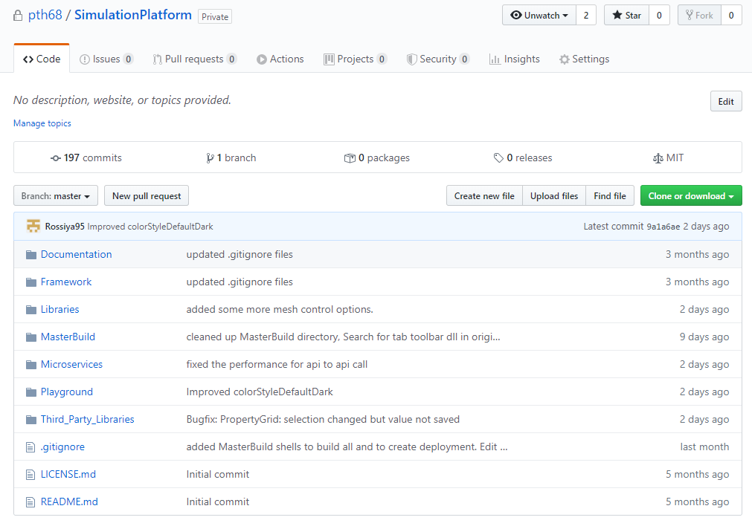
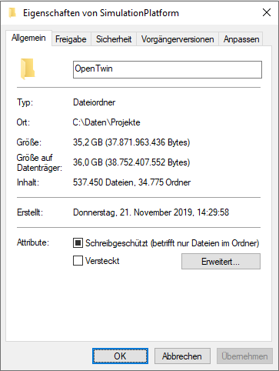
2.3 architecture and design
Open Source software
Open Twin specific parts: MIT type license
Various Open Source type licenses for third party components
Managed on GitHub: https://github.com/pth68/SimulationPlatform
Content of development branch
(including 3rd party modules)

Slide 57
Open twin introduction Agenda
✓
Challenges
1.1 Multi Domain and Multi Scale
1.2 Computational Resources
1.3 Data Management / Data Analytics
Open Twin
2.1 System Requirements Overview
2.2 Why Open Twin?
2.3 Architecture and Design
Open Twin Status and Research
Next Steps
✓
✓
✓
✓
✓
✓

Slide 58
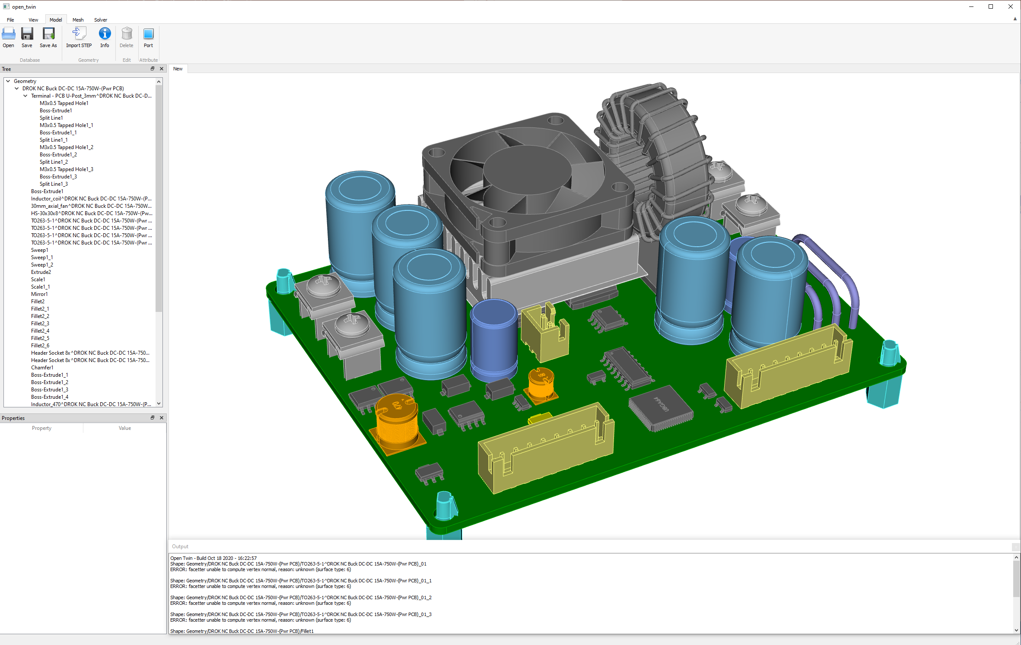
3. open Twin status

Slide 59
3. open twin status
Microservice Framework

Versioned API
Versioned API
Versioned API
Versioned API
Versioned API
Versioned API
Versioned API
User Interface
(1)
Model management
(1)
Generic visualization
(1...n)
Meshing
(1…n)
Result visualization
(1…n)
Simulator plugin
(1…n)
Automation and Optimization
(1)





Data storage


Slide 60
2. open Twin research
Example: “SecuSiM” (cloud security)
Today:
Cloud solutions provide efficient and scalable computational resources
External (or public) clouds are hosted by service provider
Application data needs to be uploaded to the cloud for running the simulations
Data transfer from and to cloud is usually encrypted and safe enough
How about the cloud system itself? Trusted service provider?
So far, application data needs to be decrypted on cloud system for simulation
SecuSIM:
Apply homomorphic encryption to run computations on the encrypted data
The data is encrypted and decrypted only on client
Matrix operations are performed on the encrypted data directly. Results can only be decrypted by the client
The project will study the feasibility / performance of this technology for simulation algorithms (FIT-TD / FDTD)
Robert Bosch GmbH supports this project through a letter of support

Slide 61
Open twin introduction Agenda
✓
Challenges
1.1 Multi Domain and Multi Scale
1.2 Computational Resources
1.3 Data Management / Data Analytics
Open Twin
2.1 System Requirements Overview
2.2 Why Open Twin?
2.3 Architecture and Design
Open Twin Status and Research
Next Steps
✓
✓
✓
✓
✓
✓
✓

Slide 62
4. Next steps
Project management
Various UI and usability improvements
Material management
Improved meshing control / parallelization
Integration of vtk for post processing visualization & pixel streaming
1D Graph library for post processing visualization
Generic simulator plugin (e.g. Studio Suite integration)
Automation (Python based) and optimization modules
Physics coupling module (based on preCICE)
Build automation / Doxygen / Unit-testing / Deployment
… tbd …

Slide 63
Thank you!
Frankfurt University of Applied Sciences, Faculty 2, ©2020 Prof. Dr.-Ing. Peter Thoma
63

